Slide 1
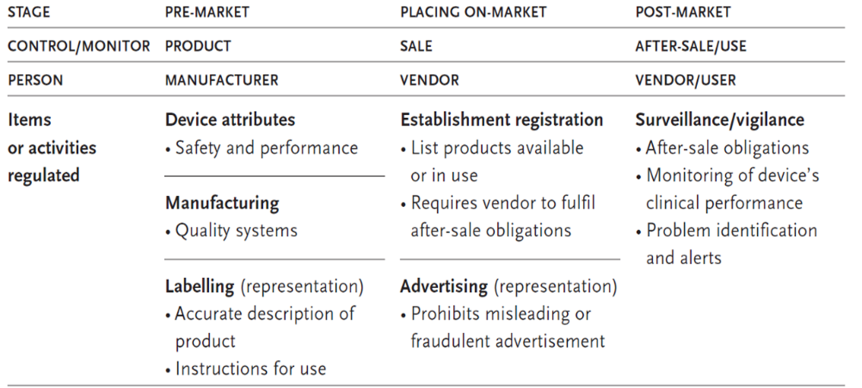
Stages of regulatory control and activities of each one
Stages of regulatory control associated with equipment life cycle
Pre-market
Placing on market
Post-market
17.2.2 Identify the stages of regulatory control and activities of each one
17.2.3 Illustrate the framework for medical equipment regulation.
17.2.4 Explain regulatory tools and requirements..
Unit C 17.2 Intro to Medical Equipment Regulation
Module 279-17-C Regulations, Standards and Ethics
dr. Chris R. Mol, BME, NORTEC, 2015

Slide 2
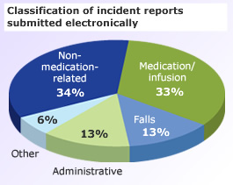
Regulation requires precisely defined, legal, language…
Adverse Event
a problem that can or does result in permanent impairment, injury or death to the patient or the user.
Incident
an unusual (unexpected) event associated with the use of a medical device. May or may not lead to problems. All incidents should be investigated for potential problems.
Problem
a broad term that covers possible faults of the device, difficulties in using the device or an undesirable outcome associated with the use of the device. A problem may not lead to an adverse event but corrective or preventive actions are required.
©
Regulatory Control
dr. Chris R. Mol, BME, NORTEC, 2015

Slide 3
Regulation requires precisely defined, legal, language…
Effectiveness
a device is clinically effective when it produces the effect intended by the manufacturer relative to the medical conditions. For example, if a device is intended for pain relief, one expects the device to actually relieve pain and would also expect the manufacturer to possess objective evidence, such as clinical test results, that the device does in fact relieve pain.
Performance
means technical performance plus effectiveness
Manufacturer
any person who produces medical devices.
Vendor
any person who sells medical devices. This person could be a manufacturer, an importer, a distributor, a wholesaler, or a retailer.
©
Regulatory Control
dr. Chris R. Mol, BME, NORTEC, 2015

Slide 4
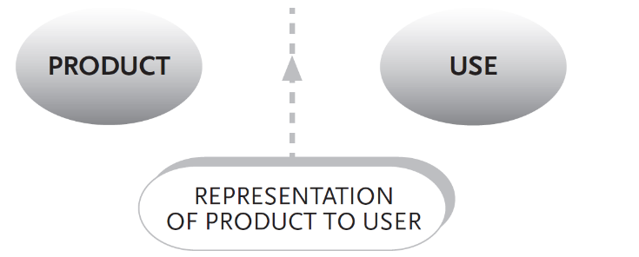
Stages covered by Regulations
Pre-market review contributes to product control.
Representation of the product to the user is controlled through labelling and advertising of the product
Post-market surveillance takes place during equipment use
©
Regulatory Control
dr. Chris R. Mol, BME, NORTEC, 2015

Slide 5
Stages covered by Regulations
Pre-market control
is performed to ensure that the product to be placed on market complies with regulatory requirements.
Labelling and Advertising control
regulates correct product representation.
Placing-on-market control
includes establishment registration, device listing and after-sale obligations.
Post-market surveillance/vigilance ensures the continued safety and performance of devices in use.
©
Regulatory Control
dr. Chris R. Mol, BME, NORTEC, 2015

Slide 6
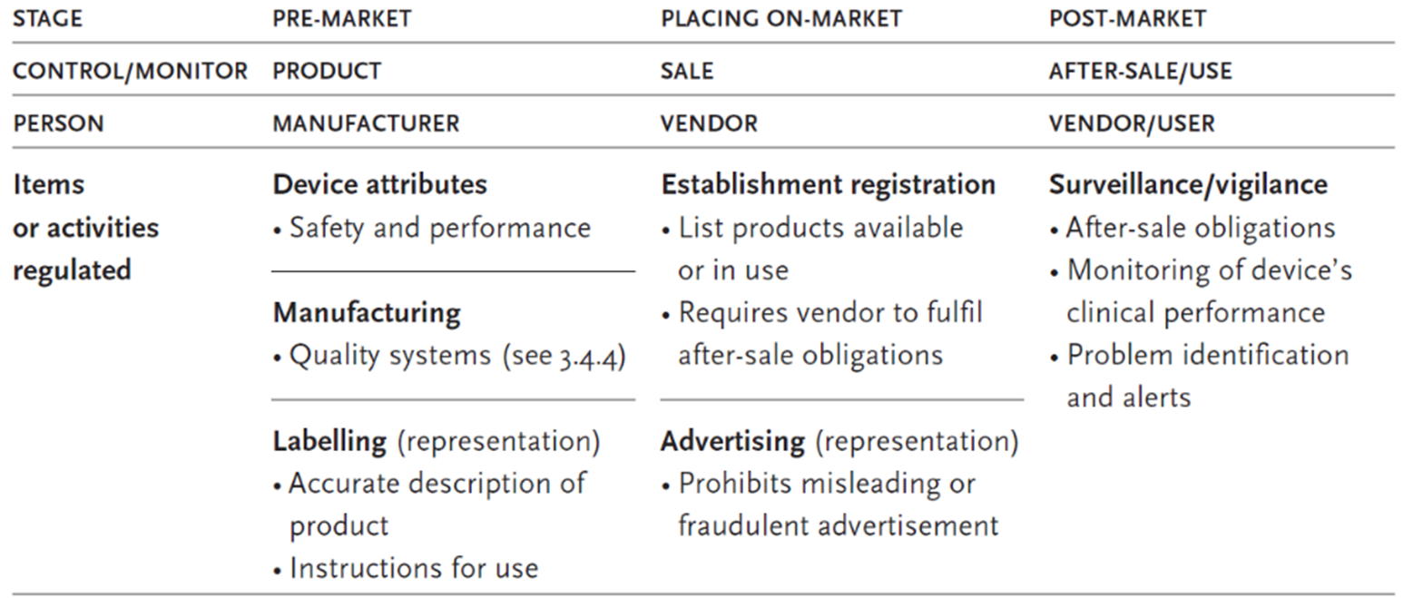
What Regulations cover (overview)
©
Regulatory Control
dr. Chris R. Mol, BME, NORTEC, 2015

Slide 7
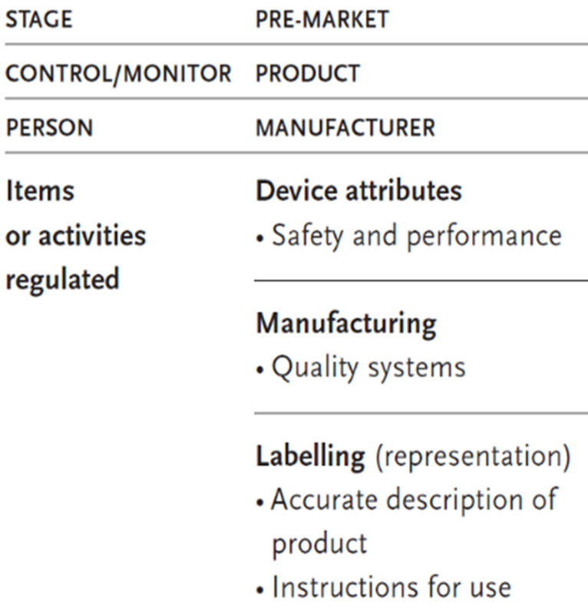
Product Control (pre-market)
©
Regulatory Control
dr. Chris R. Mol, BME, NORTEC, 2015

Slide 8
Product Control
Device Attributes: Product Safety and Performance requirements
The manufacturer needs to:
perform a risk analysis (see section 17.1)
minimize all risks via application of best practices in the industry such as:
man machine interface design
sound product architecture, design analysis, device testability, ….
……
demonstrate that any residual risks are outweighed by the patient benefits
quantitative risk and benefit analysis (see X-ray example in 17.1)
collecting proof of medical efficacy
proving that a procedure using the device has the claimed benefit on patient health
The fulfilment of these requirements is prescribed and verified by the local authorities (‘government’)
These requirements are somewhat different per country.
The following describes common elements; varying details will be described for main countries in section 17.3.
©
Regulatory Control
dr. Chris R. Mol, BME, NORTEC, 2015

Slide 9
Pre-market submission & product classification
Product Control
The degree of regulatory scrutiny increases with the potential risks of the medical device.
Low risk devices (Class I) are exempt from pre-market submissions, although they must follow the essential principles of safety and performance in their design, construction and labelling requirements.
For ‘high risk’ devices, pre-market submission is required.
This means that the manufacturer needs to get approval from the Regulatory agency to market/sell a medical device before he is allowed to start selling it.
I.e. the manufacturer must always execute the activities from the previous page, but only needs to submit these for control to regulatory authorities in case of a Class II or III device.
©
Regulatory Control
dr. Chris R. Mol, BME, NORTEC, 2015

Slide 10
Manufacturing
Product Control
Good Manufacturing Practices (GMP) contains an enormous amount of regulations on how a manufacturing operation needs to be run to deliver consistent quality and continuous improvement of processes.
For example: descriptions must be available of
all (construction) work,
all testing work,
when to approve a product,
when to repair or throw away,
how suppliers are managed,
how product problems in the field should be investigated in manufacturing,
…..
©
Regulatory Control
dr. Chris R. Mol, BME, NORTEC, 2015

Slide 11
Product Control
Packaging standards
Medical device packaging is highly regulated.
Often medical devices and products are sterilized in the package.
Sterility must be maintained throughout distribution to allow immediate use by physicians.
A series of special packaging tests measure the ability of the package to maintain sterility.
Relevant standards include (examples only):
ASTM D1585 – Guide for Integrity Testing of Porous Medical Packages
ASTM F2097 – Standard Guide for Design and Evaluation of Primary Flexible Packaging for Medical Products
EN 868 Packaging materials and systems for medical devices to be sterilized, General requirements and test methods
ISO 11607 Packaging for terminally sterilized medical devices
©
Regulatory Control
dr. Chris R. Mol, BME, NORTEC, 2015

Slide 12
Labelling & Instructions for Use
Product Control
The medium, format, content, legibility, and location of the label and instructions for use should be appropriate to the particular device, its intended purpose and the technical knowledge, experience, education or training of the intended user(s). (EU)
In particular, instructions for use should be written in terms readily understood by the intended user and, where appropriate, supplemented with drawings and diagrams. Some devices may include separate information for the professional user and the lay person.
See further in section 17-3 for specific EU/USA regulations.
‘Labelling’ also includes Advertising! See under ‘Placing on the market’.
©
Regulatory Control
dr. Chris R. Mol, BME, NORTEC, 2015

Slide 13
All regulations for manufacturers combined in ISO 13485
The international quality system standards for medical devices are issued by the International Organization for Standardization (ISO): ISO 13485.
It covers the methods, facilities and controls used by the manufacturer of medical devices in the
design (although design control is normally not required in medium- to low-risk devices)
manufacture
packaging
labelling
storage
installation
servicing
post-market handling
Every manufacturer of medical devices needs to comply with this standard in order to allow to sell in regulated countries in the world. This compliance is subject to periodic audit by governmental or third party agencies.
More on this standard in later sections
©
Regulatory Control
dr. Chris R. Mol, BME, NORTEC, 2015

Slide 14
Marketing & Sales Control (placing on the market)
©
Regulatory Control
dr. Chris R. Mol, BME, NORTEC, 2015

Slide 15
Vendor: Establishment Registration
Marketing and Sales Control
Vendor information helps governments to track medical device vendors.
The European Union requires that a responsible person of the vendor establishment with a physical address in Europe be registered.
In the United States, the establishment (manufacturers, initial importer, re-packager and/or re-labeller) must be registered with the FDA.
Also a list of devices that are or have been sold must be registered
The vendor registration process also imposes obligations on the vendor for
post-market surveillance (see further on)
©
Regulatory Control
dr. Chris R. Mol, BME, NORTEC, 2015

Slide 16
Vendor: Advertising
Marketing and Sales Control
Advertisement is prohibited before a device is cleared to enter the market (see elsewhere)
Misleading or fraudulent advertisement is prohibited:
all claims that are made in promotion materials need to be substantiated (proven); this also applies to verbal claims made in front of the customer
©
Regulatory Control
dr. Chris R. Mol, BME, NORTEC, 2015

Slide 17
Use Control (post-market)
©
Regulatory Control
dr. Chris R. Mol, BME, NORTEC, 2015

Slide 18
After Sale Obligations
Medical devices often require specialized training from the manufacturer for proper use and service; therefore, the vendor should make training a condition to the manufacturer or importer in accepting to sell the device. In turn, vendors should take responsibility in supporting or training their customers.
The manufacturer may be responsible for:
after sales support: training, spare parts delivery.
disposal: take back the product to dispose of it.
The user may be responsible for:
after sales support: training, maintenance, …
safe disposal.
©
Participants Roles
dr. Chris R. Mol, BME, NORTEC, 2017

Slide 19
Post Market Surveillance / Vigilance
Use Control
It is important that the safety and performance of medical devices are continually assessed when they are in use, as these characteristics can only be proven if one measures how a device stands up in these conditions. No amount of rigour in the pre-marketing review process can predict all possible device failures or incidents arising from device misuse. It is through actual use that unforeseen problems related to safety and performance can occur.
Common requirements include:
problem reporting
implant registration
distribution records
recall procedure
complaint handling
Learning can only take place if the actual situation is monitored and mishaps lead to improvement action...
©
Regulatory Control
dr. Chris R. Mol, BME, NORTEC, 2015

Slide 20
Post Market Surveillance / Vigilance
Use Control
Post-market surveillance is a broad term that covers all monitoring activities of medical devices in use. The two principal activities within surveillance are “post-market surveillance studies” and “adverse event reporting”.
In post-market surveillance studies, structured data collections are required of the manufacturer
as a condition of product approval, or
to re-affirm product safety when post-market adverse event reports suggest that premarket safety claims are inconsistent with actual use and result in unacceptable risk.
Adverse event reporting requires the registration and investigation of adverse events relating to the use of a device. It is mandatory for vendors or manufacturers to report all device-related events that have resulted, or could result, in serious injury or death. The regulatory authority has the right to oblige the manufacturer to recall or modify a defective device. The vendor must make arrangements for processing complaint/incident reports
In many countries, mandatory adverse event reporting is also extended to users.
©
Regulatory Control
dr. Chris R. Mol, BME, NORTEC, 2015

Slide 21
Role of BMET in Vigilance on Medical Devices
Use Control
Statistics show that many adverse events arise from low-risk devices, such as those used for injection, drainage and suction. Adverse events from low-risk devices can be just as fatal as those from high-risk devices.
In those countries where mandatory problem reporting extends to users, this has become a controversial issue. Problem reports may turn back on the user (incorrect use of the device) or on inadequate maintenance.
Since equipment safety is the responsibility of the BMET, (s)he is in a good position to conduct an investigation when an ‘adverse event’ has happened.
if user error is found, user training should be improved
if a device problem is found, this should be reported to the manufacturer and the regulator
Such reporting is often not executed to avoid a ‘people blaming culture’ (‘who was responsible for the adverse event?’) with potentially severe legal consequences.
When reporting is not done, the learning potential of errors is not used for continuous improvement of medical equipment safety.
©
Regulatory Control
dr. Chris R. Mol, BME, NORTEC, 2015

Slide 22
END
The creation of this presentation was supported by a grant from THET:
see https://www.thet.org/

